Slide 1

Session 4 & 5:
Social research methods and the basics of quantitative social analysis
主讲导师：严雪文
2022.3.4
Notes:
说明：
斜体灰色字是需要填写部分
粉色字体是说明
1

Slide 2

课程安排
1
2
3
Features of qualitative and quantitative methods
Logic of social inference
Basics of statistical methods for social sciences
Notes:
2

Slide 3
Method | Descriptions | Strengths and weaknesses | Common data collection method
Quantitative | Seek to convert information about the social world into numeric form; Use statistics to analyze these data | Strength: Breadth, generalizability; Weakness: Information can be superficial; can be subject to response bias | Survey Experiments Administrative data Texts and documents (if using quantitative analysis)
Qualitative | Seek to collect information about the social world that cannot readily be converted into numeric form Pays attention to the social world from the subjects’ point of view Resorts to story-telling and scholars’ interpretation in analyzing the data. | Strength: Provides in-depth information about individuals’ behavior and meaning-making; sheds light on social process for theorizing Weakness: Often limited to relatively small groups or settings; Not easily generalizable | Qualitative interviews Ethnography (Fieldwork) Historical and comparative analysis Texts, archives, sound and video analysis (when not using quantitative coding)
Mixed methods | Uses both quantitative and qualitative methods within the same study | Combine the benefits of both methods Could be superficial on both sides | Use fieldwork to develop hypothesis and test them for the general population with quantitative methods First collecting survey data to delineate the general trends, then use interviews to understand the social processes

Slide 4
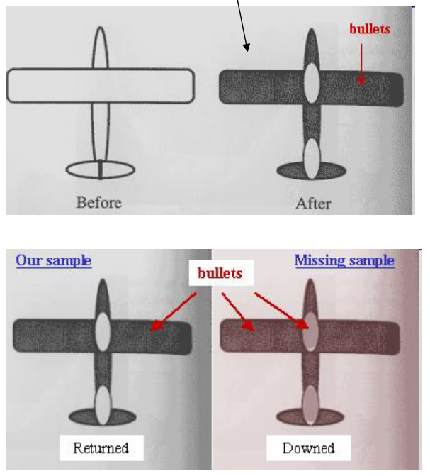
Non-response bias: example from WW2
Dark regions are those with bullet holes
Question: should we strengthen the white or dark regions to improve the survival of planes?

Slide 5
Non-response bias: example from WW1
During WWI helmets were almost withdrawn from British soldiers when it was noticed that the rate of head wounds had gone up after their issue. Some argued that helmets were making soldiers less cautious and therefore more likely to be injured…

Slide 6
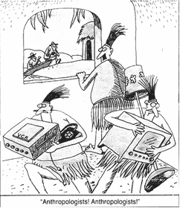
Response bias (also applicable to qualitative research)

Slide 7
Research method choice depends on the research question & the scholars’ own training/taste
Examples of quantitative studies:
Rates of intergenerational mobility (Pattern)
Relationship between economic growth and fertility decline (Trends)
The influence of socioeconomic status on health outcomes (Measurable effect)
Examples of qualitative studies:
The decision-process of panelists on proposal funding (e.g., Lamont 2009)
People’s ideas and experience about romantic love (e.g., Illouz 2014; Swidler 2001; Streib 2015)
What caused the start of capitalism? (Marx, Weber)
Notes:
and how those could be related to their class background, as well as cultural and historical contexts

Slide 8
What research method should I use?
I’m interested in understanding how a cult operates and what its members believe in.
I want to know something about the gender pay gap in China.
I want to help the government evaluate whether their job training program has been useful for reducing unemployment.
Notes:
Depends on the research question

Slide 9
Logic of social inference
“The main task of the social sciences is to explain social phenomena.” (Elster, 2007 p9)
Gary King et al. (1994) sees social inference as a fundamental task for both qualitative and quantitative social research(, although not all qualitative researchers might agree).
Inference: deduce more information about the social world from the limited observations we have
Causal inference
E.g., Does having a partner with dementia lead to more stress for the care giver?
Descriptive inference
E.g., trends of divorce in my survey data => generalizable to national trends?
Survey vs census

Slide 10
Correlation vs causation
Correlation: Two events/behaviors/characteristics vary together
E.g., Families with more books at home also have children with better academic achievement.
Causation: One event brings about another event
E.g., Having more books at home leads to an improvement in children’s academic achievement.
For quantitative research: causal inference = statistical “correlation” (non-spurious relationship) + a causal story/theory.
Relationship, association, correlation: similar meaning

Slide 11
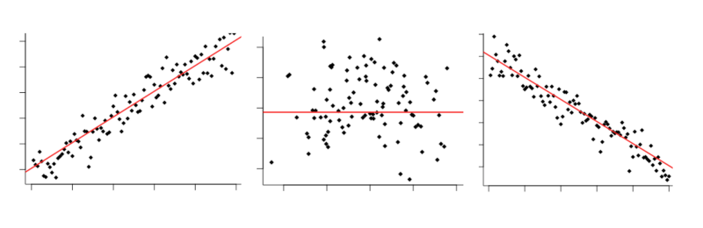
Criteria for causal claim
Statistical correlation
Temporal sequence of the events
There is no third event/variable that is associated with both two events/variables

Slide 12
Circumstances where correlation isn’t causation
Reverse causation (Dependent variable causing independent var)
E.g., Children with better achievements love reading books more and ask their parents to buy more for them!
Common cause (“confounder” variable; can also be seen as “spurious relationship”)
E.g., Higher family income leads to both more books at home and kids’ academic achievement
Self selection (Those studied/“treated” are systematically different from those that aren’t)
E.g., Parents who participated in our study are themselves more likely to care about kids’ academic achievements;
A typical problem in program evaluation

Slide 13
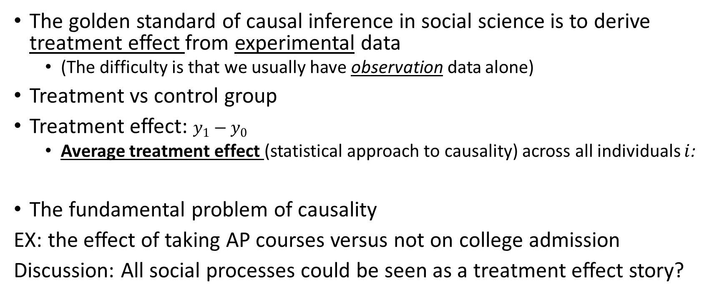

Causality: explained in terms of “treatment effect”
ASR： American Sociological Review
“counterfactual”反事实
Audit experiment

Slide 14
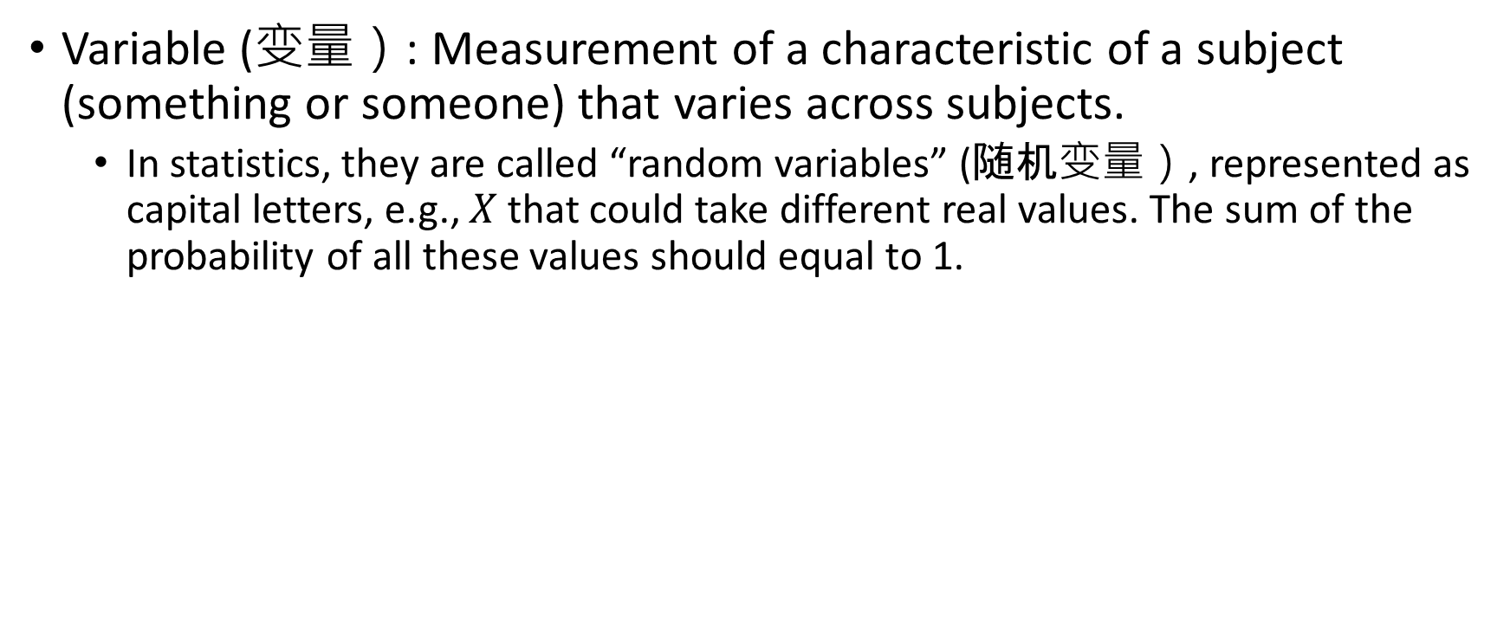
Basic vocabularies of statistics: variables

Slide 15
Types of variables
Interval level variable (定距变量): numbers are meaningful measures of the quantity;
Discrete variables
Continuous variables
Categorical variables (分类变量): The values that the variable could take only represent categories
Nominal variables
Ordered variables

Slide 16
Exercise: what type of variable is this?
age;
1-5 corresponding to highly agree – highly disagree;
gender;
educational qualification;
years of education;
income;
number of children

Slide 17
Exercise
Age: continuous (sometimes treated as discrete)
1-5 corresponding to highly agree – highly disagree: ordinal variable （but we may decide to convert them to “scores” and see them as continuous variable, depending on our theory)
Gender: categorical
educational qualification: ordinal variable
years of education: continuous variable (usually appear as discrete)
Income: continuous variable (usually appear as discrete)
Number of children: Discrete variable (count data!)

Slide 18
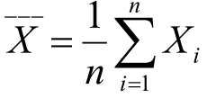
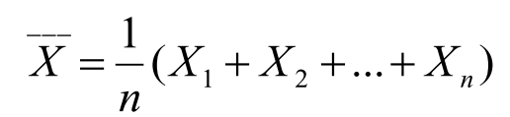
Summary Statistics
Central tendencies of a variable
Expectation (Mean/long-run average)
The expected value or mean of a random variable
E[X] for expectation, and for a sample with n observations of X
The special meaning of the mean for nominal binary data (variables that could only take values of 0 and 1): proportion!
Median
The value of the variable at 50 percentile rank
Quantile, percentile, range
Exercise : use the E notation to rewrite

Slide 19
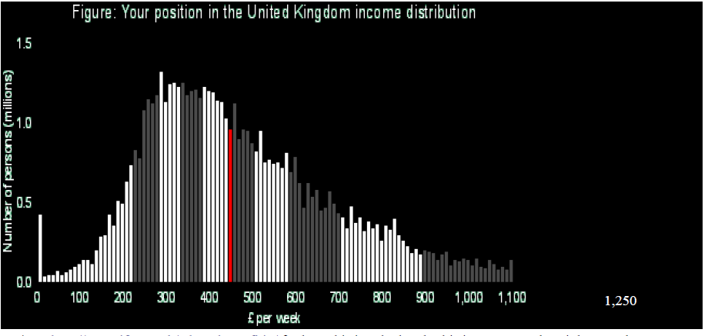
Question: Should I use the mean or the median? (histogram,‘bin’)

Slide 20
Important note: what is “distribution”?
A graph like this looks like a “(probability) distribution”. A “distribution” of a variable describes how probable/frequent the variable takes a specific value.
A probability distribution of a variable (in this example, post-tax income) has on its X axis the value that a variable is taking, and on its Y axis the “density” of the value, which is proportional to the percentage or frequency of the occurrence of that value.

Slide 21
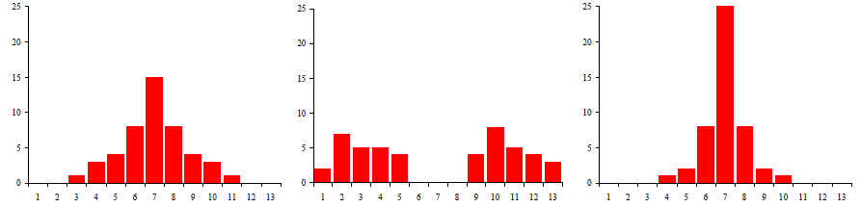
But central tendencies may not tell us everything about the distribution…

Slide 22
Summary Statistics
2. The spread/”dispersion” of the distribution of a variable
Range : the distance between the largest and smallest observations.

Slide 23


Summary Statistics
2. The spread/”dispersion” of the distribution of a variable
Range : the distance between the largest and smallest observations.
Variance: the squared sum of the difference (“deviation”) from the mean divided by the number of observation, or .
More generally, variance is the expectation of the squared deviation of a variable from its mean.
S.D. (Standard deviance = square root of Variance)

Slide 24
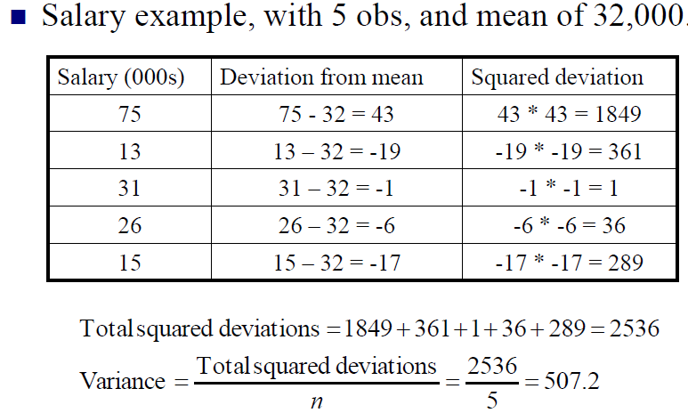
Calculating variance

Slide 25
Sample vs population
Statistic vs parameter

Slide 26
Sampling
Sampling frame
Probabilistic/random sampling: “representative” sample
Each subject within the sampling frame has the same probability of being selected.
E.g., The Reader Digest in the UK and the 1936 election
Probabilistic sampling methods
Simple random sampling 简单随机抽样
Write an algorithm?
stratified random sampling 分层抽样
Over sampling ethnic minorities?
Cluster sampling 整群抽样
Schools vs school kids

Slide 27
Measurement
Operationalization of variables
Reliability信度
Could the measurement be replicable and consistent?
Validity效度
Does the measurement correctly measure the outcomes of interest?
Internal validity
The ability for a study to make causal inferences
External validity
The generalizability of a study beyond its specific data and instance.

Slide 28
Take a minute to talk about your project?

